Slide 1
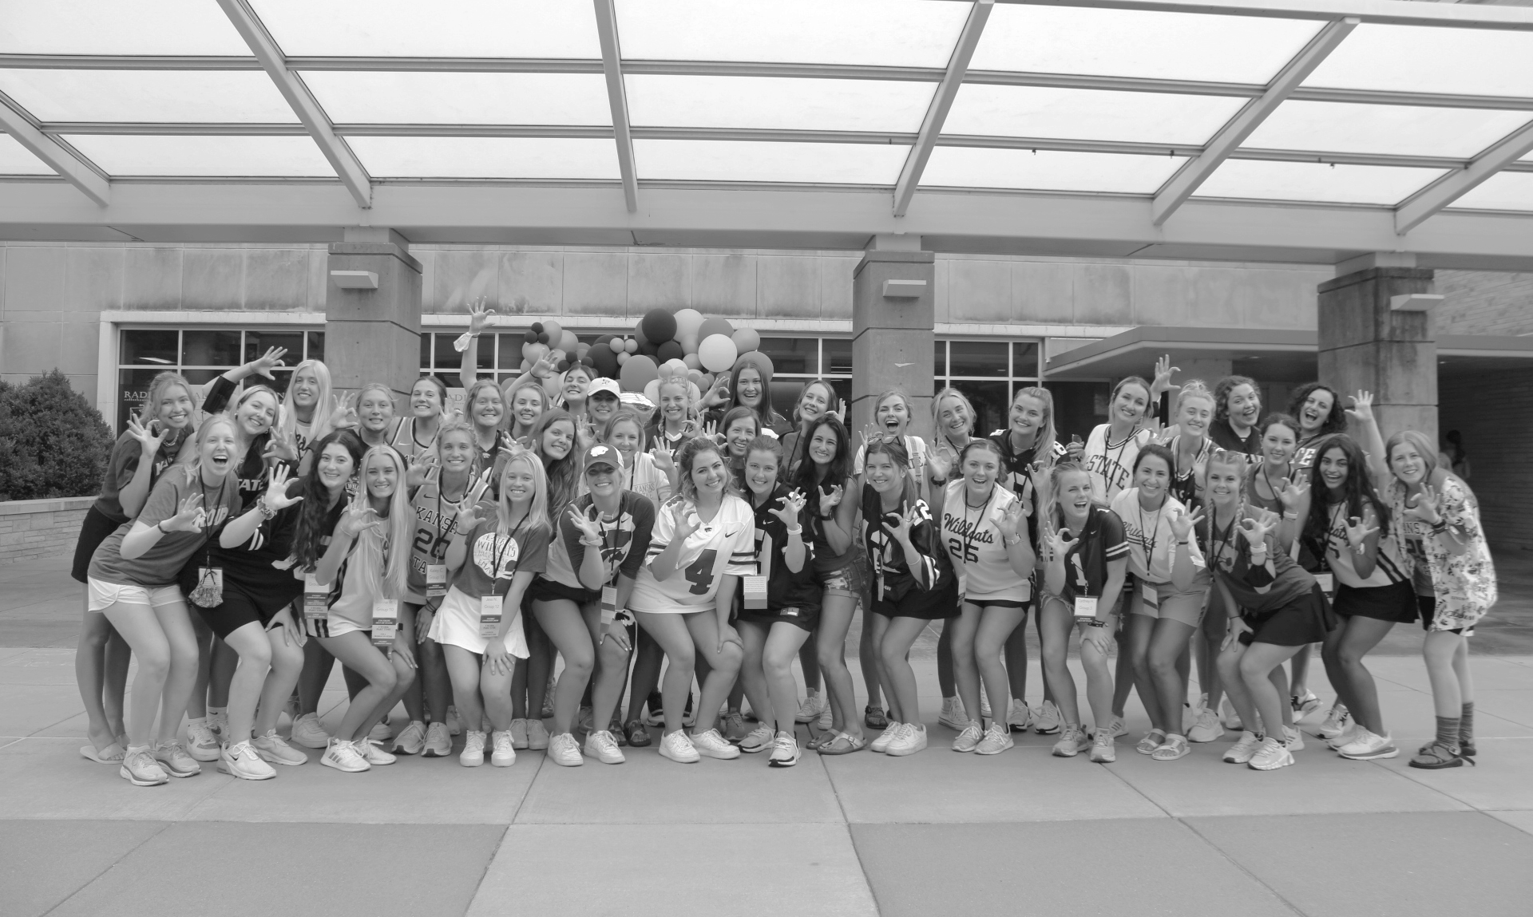
RSO Student Leadership Retreat:
Teambuilding and Burnout
Fraternity and Sorority Life
K-State Union, Office #004
greeklife@ksu.edu

Slide 2
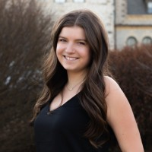
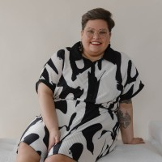
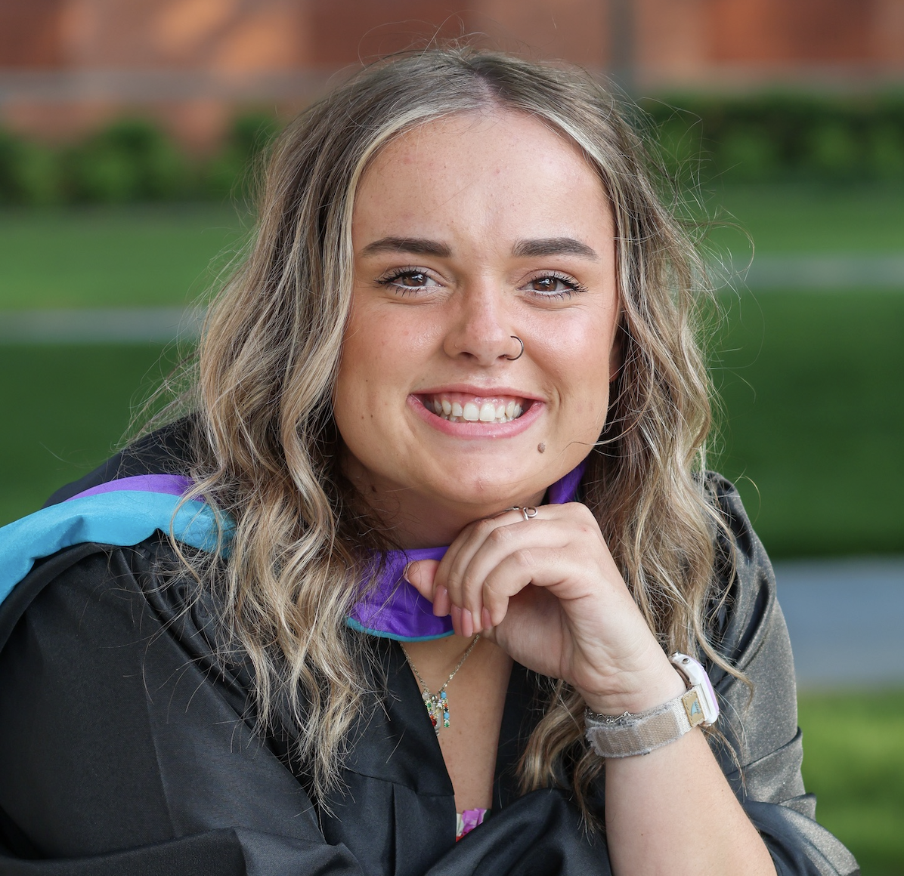
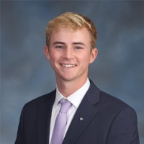
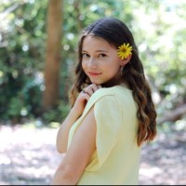
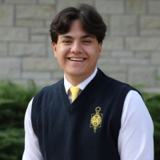
Meet the Team
Alexandria Wilson
She/Her
Assistant Director of Fraternity and Sorority Life
Dee Hawks
She/Her
Director of Fraternity and Sorority Life
Margaret Tippie
She/Her
Assistant Director of Fraternity and Sorority Life
Jake Dederer
He/Him
Graduate Assistant
Allison Heim
She/Her
Graduate Assistant
Hugh Sidabutar
He/Him
Graduate Assistant

Slide 3
Teambuilding

Slide 4
Do you believe you are part of a strong leadership team?
Why or why not?

Slide 5
When your leadership team is strong, how does your organization function differently?

Slide 6
When your team is NOT functioning well, how is that felt across the leadership board? the general member?

Slide 7
Burnout

Slide 8
When during the year are you and your leaders experiencing burnout?

Slide 9
How do you see burnout affecting your organization?

Slide 10
What (if anything) have you done to attempt to limit burnout? Did it work? Why or why not?

Slide 11
BURNOUT TIPS
REVERSE
RECOGNIZE
RESILIENCE
https://www.helpguide.org/articles/stress/burnout-prevention-and-recovery.htm

Slide 12
How can we help you navigate leadership, teambuilding, and burnout?

Slide 13
Thank You & Go Cats!!
@kstatefsl
FOLLOW US ON INSTAGRAM TO STAY UP TO DATE ON ALL THINGS FRATERNITY & SORORITY AT K-STATE

